Slide 1

SOFTWARE ENGINEERING AND PROJECT MANAGEMENT (CSE 227)
Department of Computer Science and Engineering
School of Engineering,
PRESIDENCY UNIVERSITY

Slide 2
Module 4: Software Project Management (13 hrs) – Application level
Project Management Concepts, Project Planning, Overview of metrics, Estimation for Software projects, Project Scheduling, Risk Management, Maintenance and Reengineering, Software Process Improvement (SPI): CMM Levels.

Slide 3
Product Metrics
Department of Computer Science and Engineering
School of Engineering, Presidency University

Slide 4
Software Metric
A software metric is a standard of measure of a degree to which a software system or process possesses some property.
Metrics can be defined for requirements, design, coding, testing stages of SDLC.

Slide 5
Function Point (FP) Metric
The function point (FP) metric can be used effectively as a means for measuring the functionality delivered by a system.
A Function Point (FP) is a unit of measurement to express the amount of business functionality, an information system (as a product) provides to a user. FPs measure software size. They are widely accepted as an industry standard for functional sizing.

Slide 6
Function Point (FP) Metric
The FP metric can be used to:
(1) estimate the cost or effort required to design, code, and test the software;
(2) predict the number of errors that will be encountered during testing; and
(3) forecast the number of components and/or the number of projected source lines in the implemented system.

Slide 7
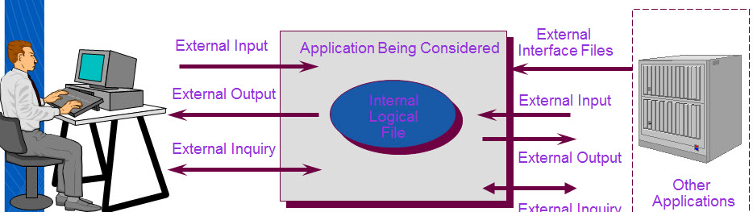
Function Point (FP) Metric
Information Domain Values:
Number of External Inputs
Number of External Outputs
Number of External Inquiries
Number of Internal Logical Files
Number of External Interface Files

Slide 8
FP - Information Domain Values
Number of External Inputs
Each external input originates from a user or is transmitted from another application
They provide distinct application-oriented data or control information
They are often used to update internal logical files
They are not inquiries (those are counted under another category)

Slide 9
FP - Information Domain Values
Number of External Outputs
Each external output is derived within the application and provides information to the user
This refers to reports, screens, error messages, etc.
Individual data items within a report or screen are not counted separately

Slide 10
FP - Information Domain Values
Number of External Inquiries
An external inquiry is defined as an online input that results in the generation of some immediate software response
The response is in the form of an on-line output.
Number of Internal Logical Files
Each internal logical file is a logical grouping of data that resides within the application’s boundary and is maintained via external inputs

Slide 11
FP - Information Domain Values
Number of External Interface Files
Each external interface file is a logical grouping of data that resides external to the application but provides data that may be of use to the application
Function Point Calculator: http://groups.umd.umich.edu/cis/course.des/cis375/projects/fp99/fp_leader.html
Compute the number of function points (FP)
FP = count total * [0.65 + 0.01 * sum(F_{i})]

Slide 12
Fi – Value Adjustment Factors
The Fi (i 1 to 14) are value adjustment factors (VAF) based on responses to the following questions:
1. Does the system require reliable backup and recovery?
2. Are specialized data communications required to transfer information to or from the application?
3. Are there distributed processing functions?
4. Is performance critical?
5. Will the system run in an existing, heavily utilized operational environment?
6. Does the system require online data entry?
7. Does the online data entry require the input transaction to be built over multiple screens or operations?

Slide 13
Fi – Value Adjustment Factors
8. Are the ILFs updated online?
9. Are the inputs, outputs, files, or inquiries complex?
10. Is the internal processing complex?
11. Is the code designed to be reusable?
12. Are conversion and installation included in the design?
13. Is the system designed for multiple installations in different organizations?
14. Is the application designed to facilitate change and ease of use by the user?

Slide 14
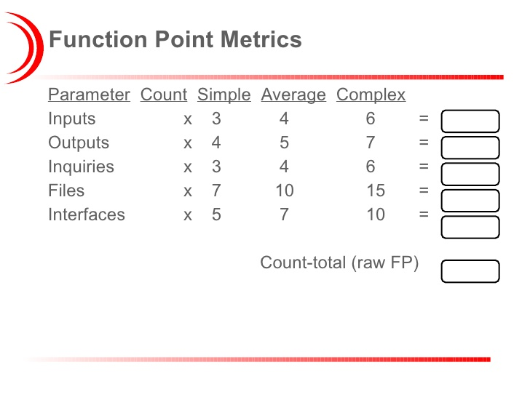
Computing Function Points

Slide 15
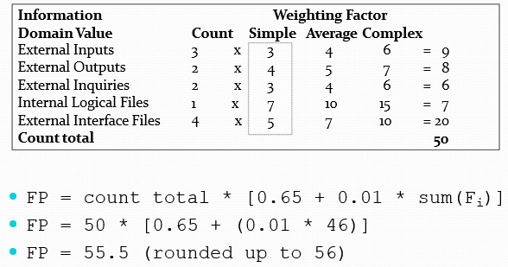
Function Point Example
Productivity = FP/ Person_month
Quality = Defects / FP

Slide 16
Architectural Design Metrics
These metrics place emphasis on the architectural structure and effectiveness of modules or components within the architecture.
They are “black box” in that they do not require any knowledge of the inner workings of a particular software component.
Card and Glass define three software design complexity
measures:
Structural complexity
Data complexity
System complexity

Slide 17
Architectural Design Metrics
For hierarchical architectures (e.g., call-and-return architectures), structural complexity of a module i is defined in the following manner:
S(i) = fout(i)
where fout(i) is the fan-out of module i.
Fan-out is defined as the number of modules immediately subordinate to module i; that is, the number of modules that are directly invoked by module i.

Slide 18
Architectural Design Metrics
Data complexity provides an indication of the complexity in the internal interface for a module i and is defined as
D(i) = v(i)/[f (i) + 1]
 where v(i) is the number of input and output variables that are passed to and from module i.
System complexity is defined as the sum of structural and data complexity, specified as
C(i) = S(i) + D(i)

Slide 19
Class Oriented Metrics
The CK Metrics Suite comprises of Six class-based design metrics for OO systems namely:
Weighted methods per class (WMC):-
The normalized complexity of the methods in a class
Indicates the amount of effort to implement and test a class
Depth of the inheritance tree(DIT):-
The maximum length from the derived class (the node) to the base class (the root)
Indicates the potential difficulties when attempting to predict the behavior of a class because of the number of inherited methods

Slide 20
Class Oriented Metrics
Number of children(NOC) (i.e., subclasses):-
As the number of children of a class grows
Reuse increases
The amount of testing required will increase
Coupling between object classes(CBO)
Measures collaboration between classes
Coupling should be kept low, since higher coupling decreases the reusability of a class

Slide 21
Class Oriented Metrics
Response for a Class (RFC)
This is the set of methods that can potentially be executed in a class in response to a public method call from outside the class
As the response value increases, the effort required for testing also increases as does the overall design complexity of the class
Lack of Cohesion in Methods (LCOM)
This measures the number of methods that access one or more of the same instance variables (i.e., attributes)of a class
If no methods access the same attribute, then the measure is zero
As the measure increases, methods become more coupled to one another via attributes, increasing the complexity of class design

Slide 22
Metrics for Maintenance
Metric = [M_{T} - (F_{a} + F_{c} + F_{d} )]/ M_{T}
Where
M_{T} = number of modules in the current release
F_{a} = number of modules in the current release that have been added
F_{c} = number of modules in the current release that have been changed
F_{d} = number of modules from the preceding release that were deleted in the current release

Slide 23
WebApp Project Metrics
Number of static Web pages (the end-user has no control over the content displayed on the page)
Number of dynamic Web pages (end-user actions result in customized content displayed on the page)
Number of internal page links (internal page links are pointers that provide a hyperlink to some other Web page within the WebApp)
Number of persistent data objects
Number of external systems interfaced
Number of static content objects
Number of dynamic content objects
Number of executable functions

Slide 24
Defect Removal Efficiency
DRE = E /(E + D)
where:
E is the number of errors found before delivery of the software to the end-user
D is the number of defects found after delivery.

